Slide 1


BENGALURU CAMPUS
PROJECT TITLE :
CREDIT WORTHINESS EVALUATION
PROJECT BY
VASUDEV R NAIR
DETAILS
PGPDSC-FT-B-AUGUST 2023
FINANCE DOMAIN
GUIDED BY
SAI SOURABH REDDY P
SENIOR DATA ANALYST
UBER – EXT
Unlocking Financial Confidence: Your Trustworthy Partner in Credit Worthiness Evaluation.

Slide 2



PROBLEM DEFINITION
The objective is to develop a predictive model that assesses an individual's ability to repay a loan. The binary target variable is defined as follows: 1 indicates "Unable to pay the loan," and 0 signifies "Able to pay the loan." The dataset encompasses diverse features such as gender, salary, details about the individual's residence, familial information, marital status, and more. Through a careful analysis of these attributes, the model aims to distinguish patterns indicative of financial stability or risk, assisting financial institutions in making informed decisions on loan approvals based on an individual's creditworthiness.
VALUE ADDITIONS ADDED
Explainability and Transparency
Continuous Learning
Fairness and Bias Mitigation
User-Friendly Interface
Security Measures
Education and Communication
Benchmarking and Model Comparison
IMPORTANCE OF THE PROBLEM
Enhance decision-making, reduce the likelihood of defaults, and ensure fair and efficient allocation of resources, contributing to the overall stability and sustainability of the financial system.
TECHNOLOGY PROBLEM RESOLVED
Feature Selection and Engineering, Model Training and Evaluation,
Data Quality and Preprocessing, Interpretability, Scalability and Performance.
BUSINESS PROBLEM RESOLVED
Risk Mitigation, Customer Segmentation, Regulatory Compliance, Operational Efficiency, Customer Trust

Slide 3


SUGGESTED SOLUTION
CONSIDERED DATASET
DATASET SELECTION
File name :
application_data.csv
From :
Dimension :
EXPL DATA ANALYSIS
307511 x 122
1
2
The dataset aims to predict an individual's ability to repay a loan, with the target variable being whether they are "ABLE" or "UNABLE" to repay. Features include gender, age, loan amount, annual income, property information, car ownership status and many more. The dataset is designed for assessing creditworthiness and making informed lending decisions.
3
CHECKING ASSUMPTIONS
FEATURE ENGINEERING
4
5
MODELS DEVELOPMENT
MODEL EVALUATION
6
7
RISK USERS
MODEL IMPROVEMENT
UI DEVELOPMENT
8

Slide 4
FEATURES IN DATASET
16 | NAME_HOUSING_TYPE | What is the housing situation of the client (renting, living with parents, ...)
17 | REGION_POPULATION_RELATIVE | Popoulation normalized value, higher value indicates more population in the area
18 | DAYS_BIRTH | Client's age in days at the time of application
19 | DAYS_EMPLOYED | How many days before the application the person started current employment
20 | DAYS_REGISTRATION | How many days before the application did client change his registration
21 | DAYS_ID_PUBLISH | How many days before the application did client change the identity document with which he applied for the loan
22 | OWN_CAR_AGE | Age of client's car
23 | FLAG_MOBIL | Did client provide mobile phone (1=YES, 0=NO)
24 | FLAG_EMP_PHONE | Did client provide work phone (1=YES, 0=NO)
25 | FLAG_WORK_PHONE | Did client provide home phone (1=YES, 0=NO)
26 | FLAG_CONT_MOBILE | Was mobile phone reachable (1=YES, 0=NO)
27 | FLAG_PHONE | Did client provide home phone (1=YES, 0=NO)
28 | FLAG_EMAIL | Did client provide email (1=YES, 0=NO)
29 | OCCUPATION_TYPE | What kind of occupation does the client have
30. | CNT_FAM_MEMBERS | How many family members does client have
31 | REGION_RATING_CLIENT | Our rating of the region where client lives (1,2,3)
32 | REGION_RATING_CLIENT_W_CITY | Our rating of the region where client lives with taking city into account (1,2,3)
33 | WEEKDAY_APPR_PROCESS_START | On which day of the week did the client apply for the loan
34 | HOUR_APPR_PROCESS_START | Approximately at what hour did the client apply for the loan
35 | REG_REGION_NOT_LIVE_REGION | Flag if client's permanent address does not match contact address (1=different, 0=same, at region level)
36 | REG_REGION_NOT_WORK_REGION | Flag if client's permanent address does not match work address (1=different, 0=same, at region level)
37 | LIVE_REGION_NOT_WORK_REGION | Flag if client's contact address does not match work address (1=different, 0=same, at region level)
38 | REG_CITY_NOT_LIVE_CITY | Flag if client's permanent address does not match contact address (1=different, 0=same, at city level)
39 | REG_CITY_NOT_WORK_CITY | Flag if client's permanent address does not match work address (1=different, 0=same, at city level)
40 | LIVE_CITY_NOT_WORK_CITY | Flag if client's contact address does not match work address (1=different, 0=same, at city level)
41 | ORGANIZATION_TYPE | Type of organization where client works
42 | EXT_SOURCE_1 | Normalized score from external data source
43 | EXT_SOURCE_2 | Normalized score from external data source
44 | EXT_SOURCE_1 | Normalized score from external data source
Slno | Col name | Description
1 | SK_ID_CURR | ID of loan in our sample
2 | TARGET | Unable to pay the loan 0 - Able to pay the loan
3 | NAME_CONTRACT_TYPE | Identification if loan is cash or revolving
4 | CODE_GENDER | Gender of the client
5 | FLAG_OWN_CAR | Does the client own a car
6 | FLAG_OWN_REALTY | Does the client has a property or not
7 | CNT_CHILDREN | Number of children the client has
8 | AMT_INCOME_TOTAL | Income of the client
9 | AMT_CREDIT | total amount of money that is borrowed by the client
10 | AMT_ANNUITY | Amount paid / year
11 | AMT_GOODS_PRICE | For consumer loans it is the price of the goods for which the loan is given
12 | NAME_TYPE_SUITE | Who accompanied client when applying for the previous application
13 | NAME_INCOME_TYPE | Clients income type (businessman, working, maternity leave,…)
14 | NAME_EDUCATION_TYPE | highest education level the client achieved
15 | NAME_FAMILY_STATUS | Marital status of the client
Columns 45 -95 normalized info about residential house
Columns 96- 116 whether client submitted the doc #
117 | AMT_REQ_CREDIT_BUREAU_HOUR | Credit Bureau is an agency that collects and maintains credit information on individuals.
118 | AMT_REQ_CREDIT_BUREAU_DAY | Number of enquiries to Credit Bureau about the client one day before application (excluding one hour before application)
119 | AMT_REQ_CREDIT_BUREAU_WEEK | Number of enquiries to Credit Bureau about the client one week before application (excluding one day before application)
120 | AMT_REQ_CREDIT_BUREAU_MON | Number of enquiries to Credit Bureau about the client one month before application (excluding one week before application)
121 | AMT_REQ_CREDIT_BUREAU_QRT | Number of enquiries to Credit Bureau about the client 3 month before application (excluding one month before application)
122 | AMT_REQ_CREDIT_BUREAU_YEAR | Number of enquiries to Credit Bureau about the client one day year (excluding last 3 months before application)

Slide 5
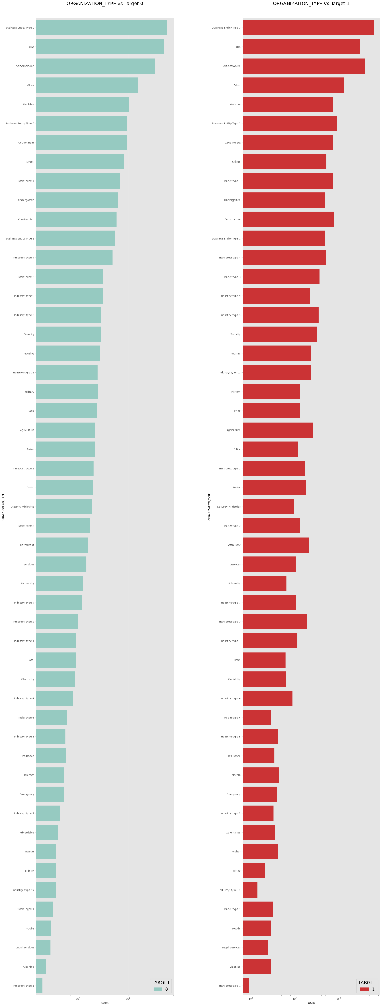
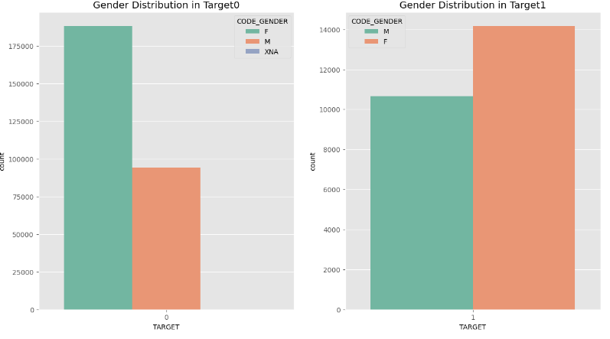
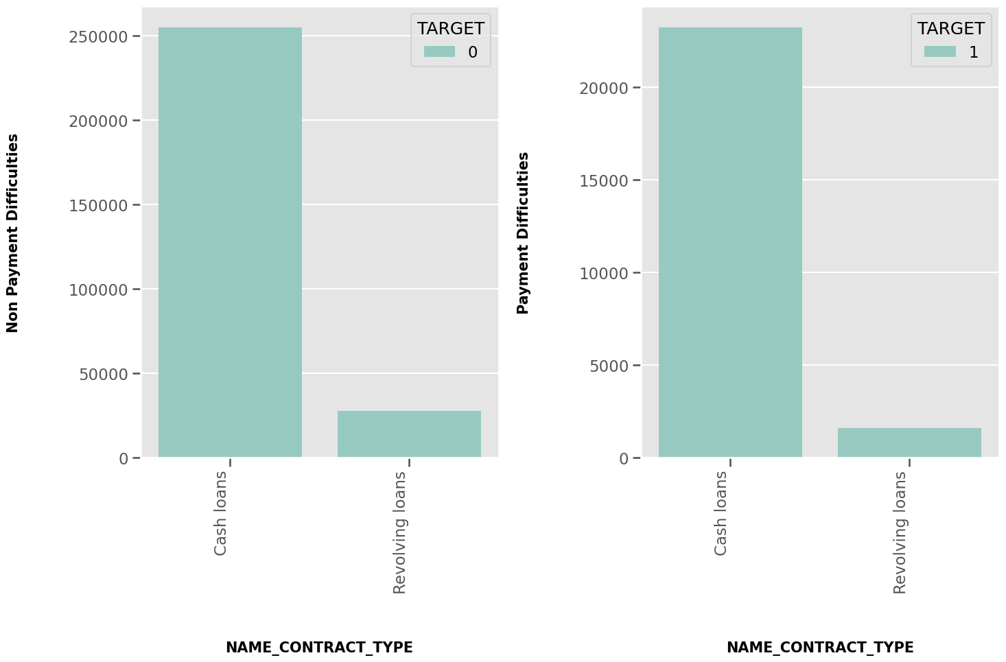
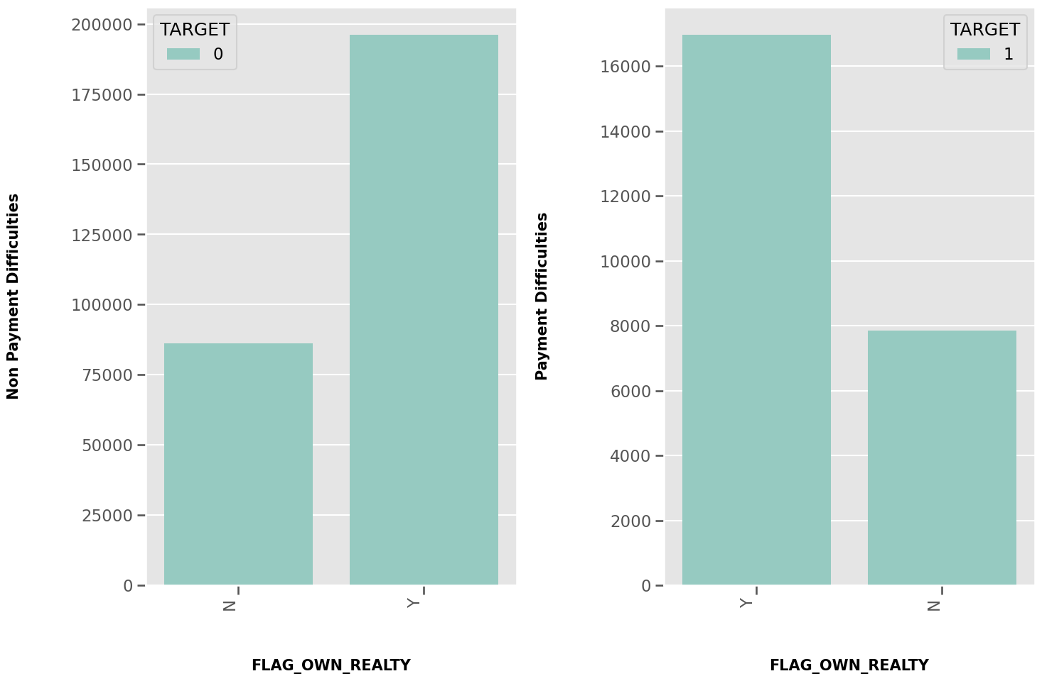
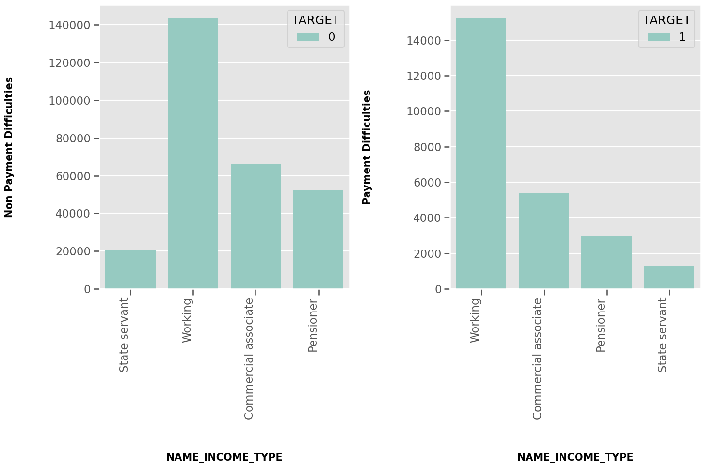
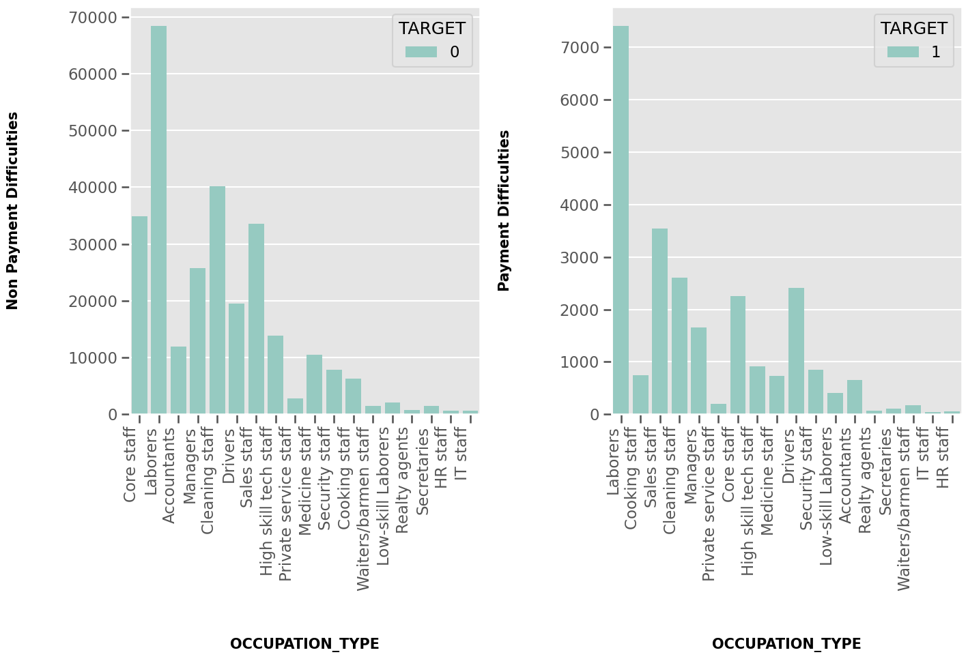
EXPLORATORY DATA ANALYSIS
There is no considerable difference in days for both Defaulters and Non-defaulters.
Laborers have applied the most for the loan in case of Defaulters and Non-Defaulters.
Laborers being highest followed by Cleaning Staff have high risk to default.
From the bar chart, it is clear that Most of the clients own a house or living in a apartment for both Defaulters and Non-Defaulters.
Married Clients seems to be applied most for the loan compared to others for both Defaulters and Non-Defaulters.
In case of Defaulters,Clients having single relationship are less risky
In case of Defaulters, Widows shows Minimal risk.
Clients having education Secondary or Secondary Special are more likey to apply for the loan.
Clients having education Secondary or Secondary Special have higher risk to default.Other education types have minimal risk.
Clients who applied for loans were getting income by Working Professional are more likely to apply for the loan, highest being the Working class category .
State servant are less likely to apply for loan .
Working category have high risk to default.
State Servant is at Minimal risk to default.
Most of the clients have applied for Cash Loan while **very small proportion ** have applied for Revolving loan for both Defaulters as well as Non-defaulters.
Clients who owns a realty have applied the most for the loan.
1. Univariante Analysis
It seems like Female clients applied higher than male clients for loan
66.6% Female clients are non-defaulters while 33.4% male clients are non-defaulters.
57% Female clients are defaulters while 42% male clients are defaulters.
(Defaulters as well as Non-defaulters) Clients with ORGANIZATION_TYPE Business Entity Type 3, Self-employed, Other ,Medicine, Government,Business Entity Type 2 applied the most for the loan as compared to others
(Defaulters as well as Non-defaulters) Clients having ORGANIZATION_TYPE Industry: type 13, Trade: type 4, Trade: type 5, Industry: type 8 applied lower for the loan as compared to others

Slide 6
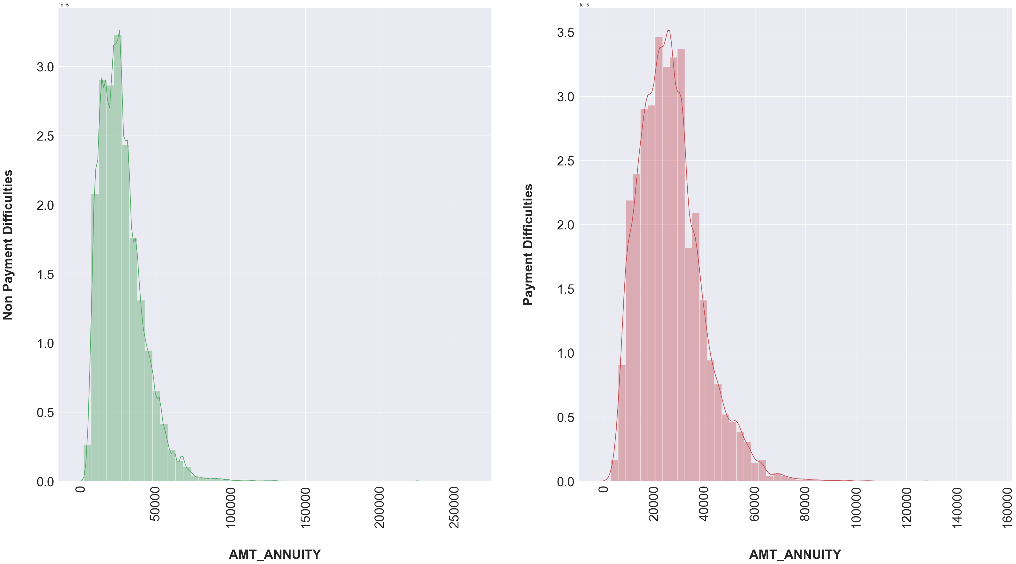
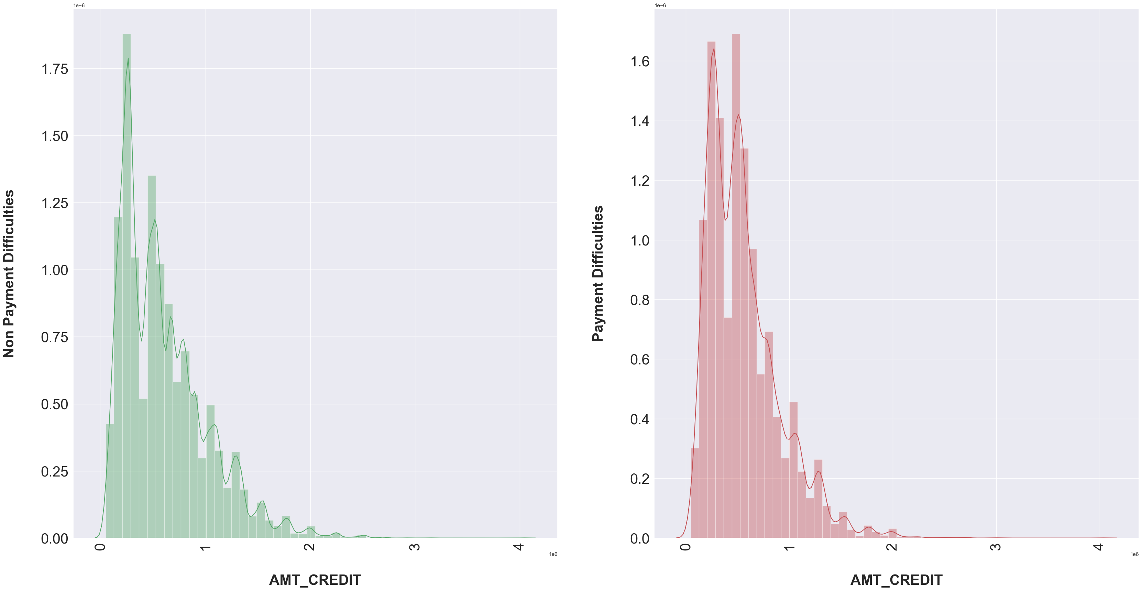
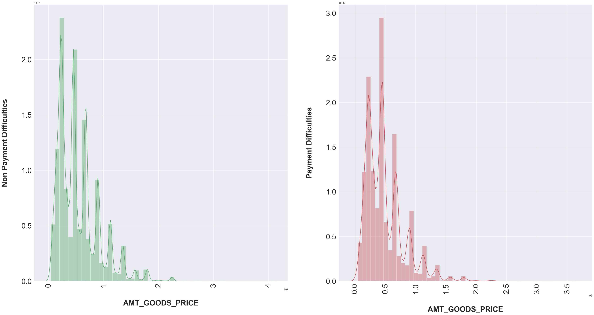
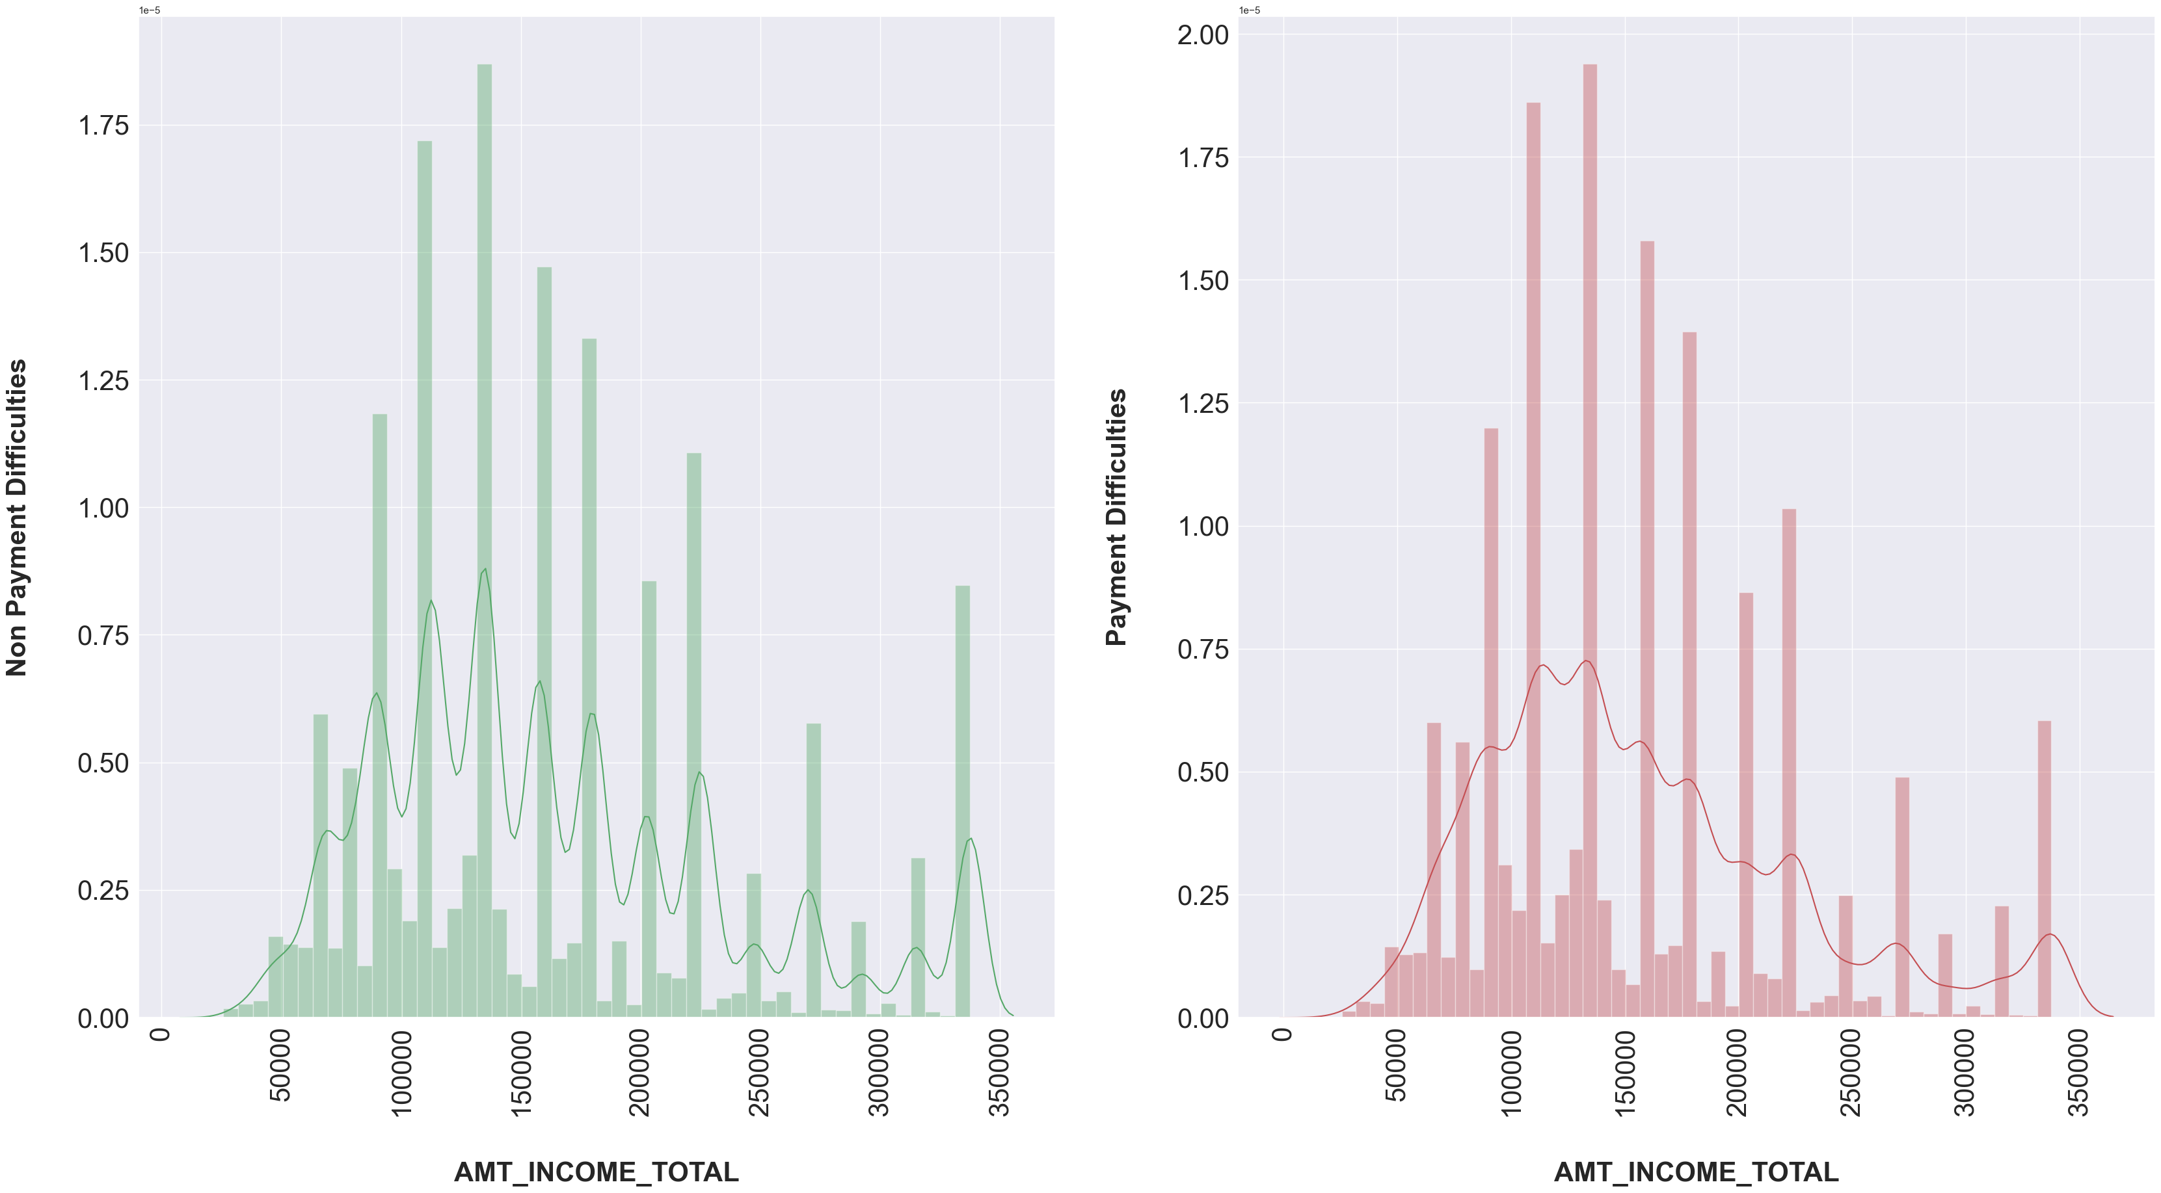
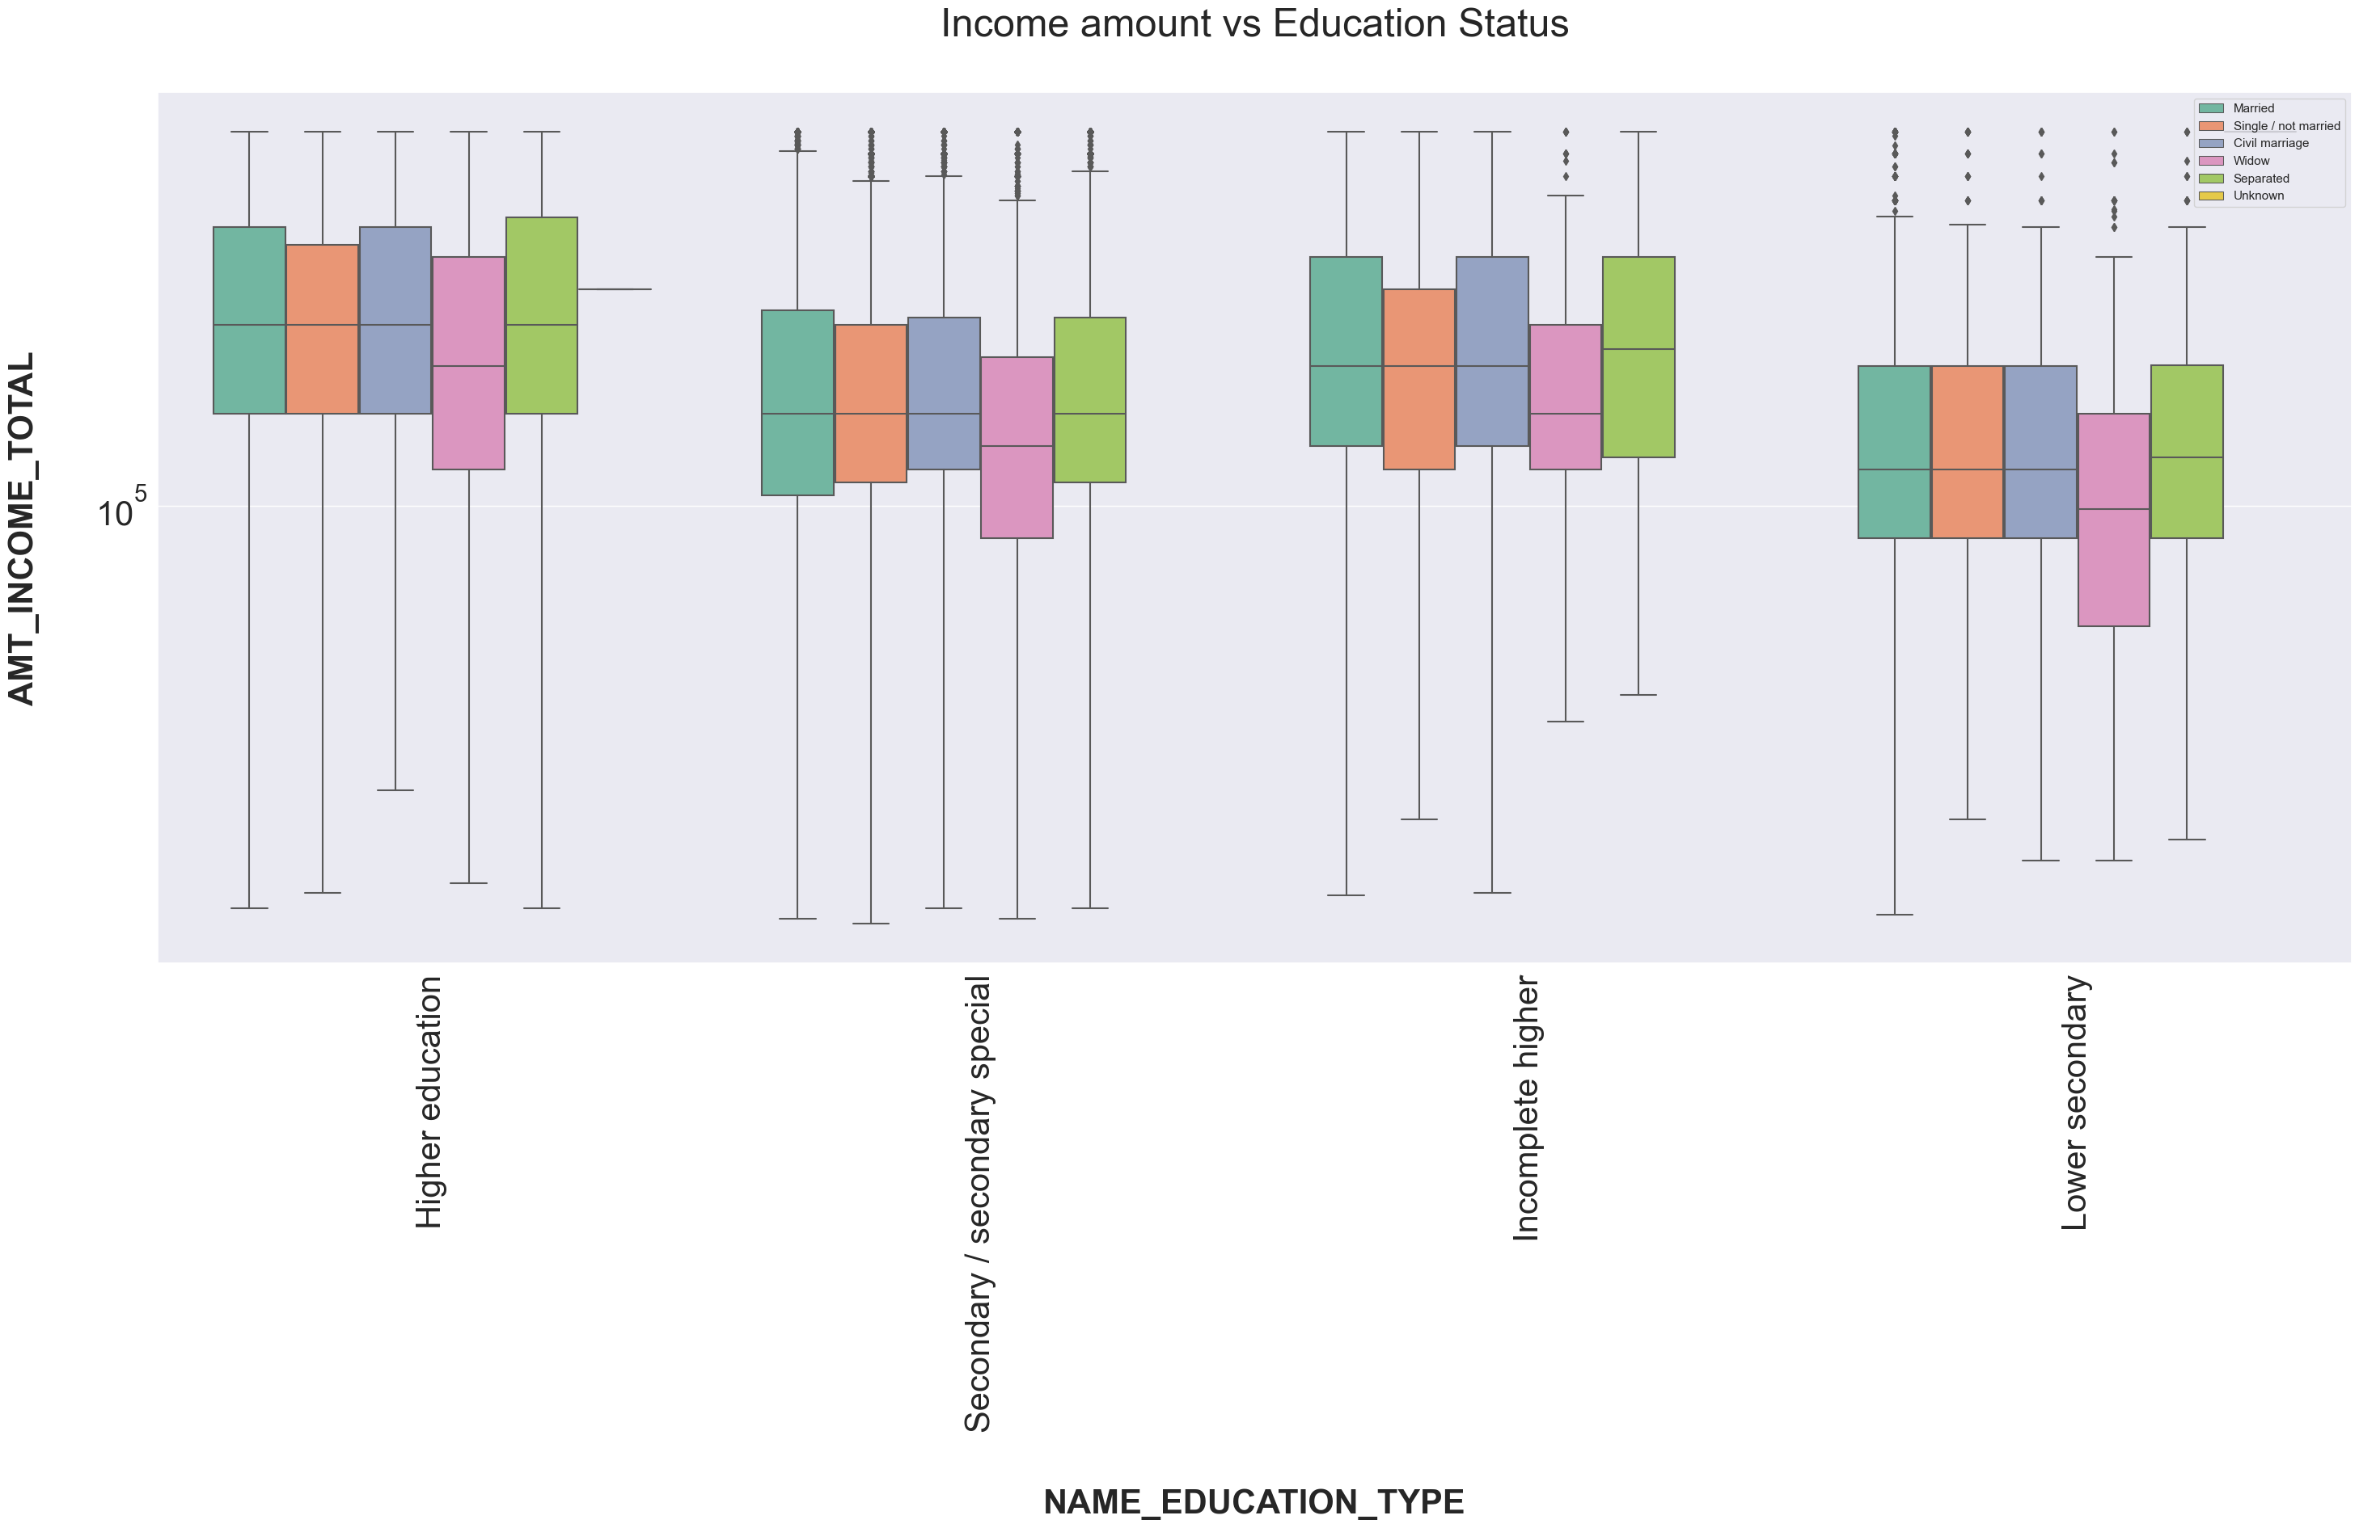
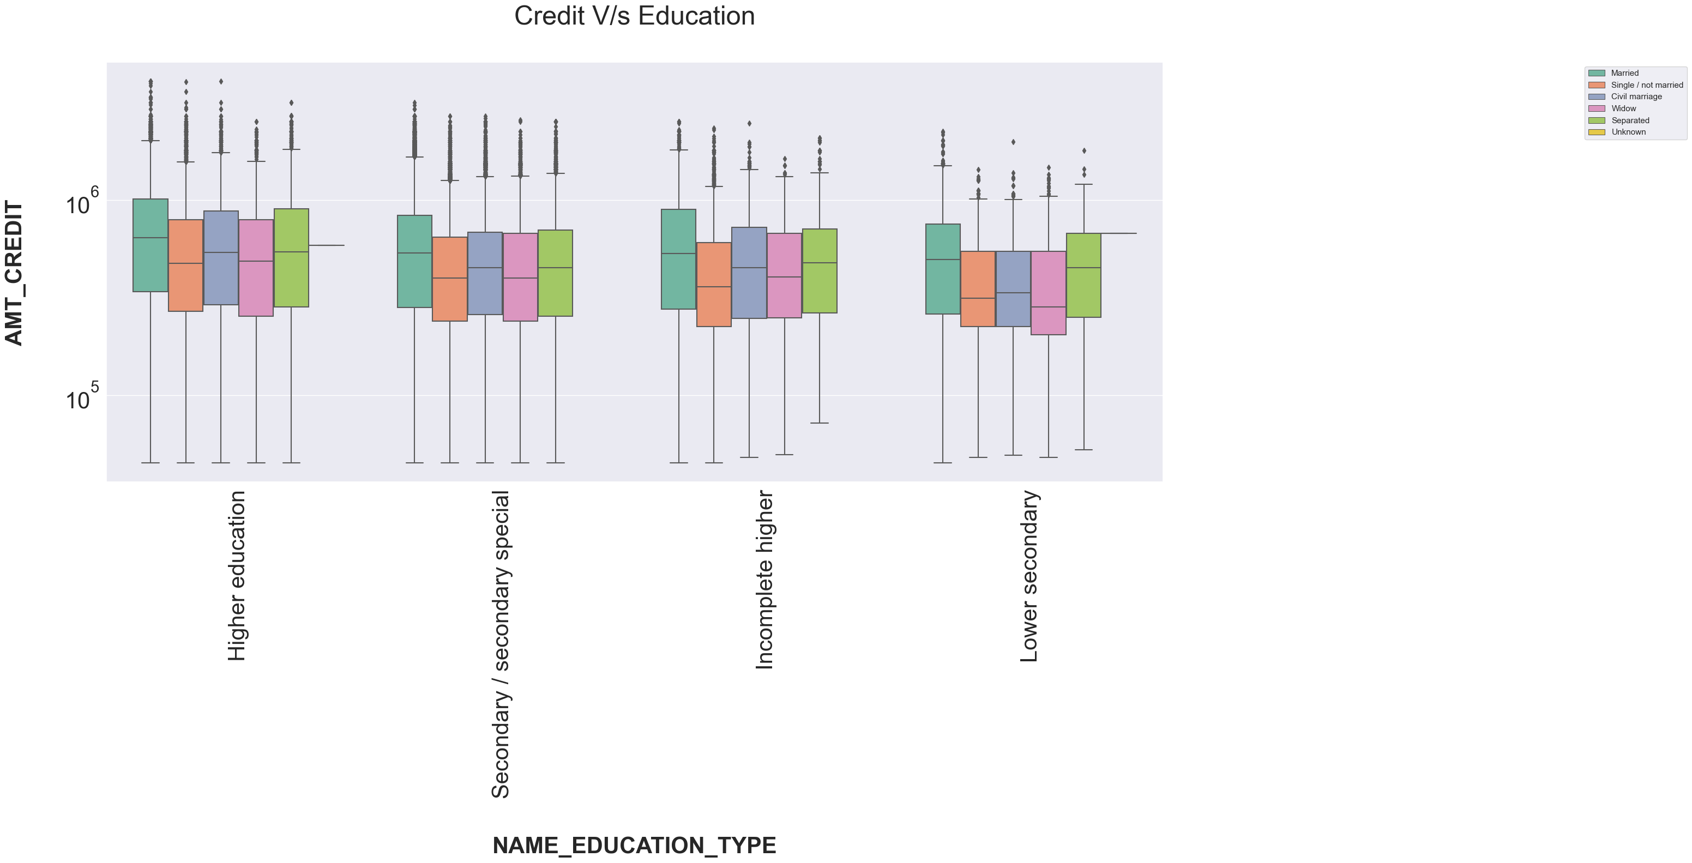
INCOME AMOUNT VS EDUCATION STATUS
Widow Client with Academic degree have a very few outliers and doesn't have First and Third quartile.Also Clients with all type of family status having academic degree have very less outliers as compared to other type of education.
Income of the clients with all type of family status having rest of the education type lie Below the First quartile i.e. 25%
Clients having Higher Education, Incomplete Higher Education, Lower Secondary Education and Secondary/Secondary Special have a higher number of outliers.
From the above figure we can say that, some of the clients having Higher Education tend to have highest Income compared to others.
Though some of the clients who haven't completed their Higher Education tend to have higher Income.
Some of the clients having Secondary/Secondary Sepcial Eduacation tend to have higher income.
CREDIT VS EDUCATION
Clients with different Education type except Academic degree have large number of outliers
Most of the population i.e. cliends credit amounts lie below 25%.
Clients with Academic degree and who is a widow tend to take higher credit loan.
Some of the clients with Higher Education, Incomplete Higher Education, Lower Secondary Education and Secondary/Secondary Special Eduacation are more likely to take high amount of credit loan.
People with target one has largely staggered income as compared to target zero. Dist. plot clearly shows that the shape in Income total, Annuity, Credit and Good Price are similar for Target 0 and similar for Target 1.
The plots are also highlighting that people who have difficulty in paying back loans with respect to their income, loan amount, price of goods against which loan is procured and Annuity.
Dist. plot highlights the curve shape which is wider for Target 1 in comparison to Target 0 which is narrower with well defined edges.

Slide 7

DATA PREPROCESSING
1
2
BASE MODEL
FINAL MODEL
Around 50 columns had more than 35% + missing values
Bottom – up strategy
Naïve imputation done for missing values less than 5%
Reason for missing values
Categorized the missing values
Outlier Handling
Added to the model based on assumptions
Around 50 columns had more than 35% + missing values
Dropped columns having missing % more than 35
Used naïve imputation methods based on skewness
Removed outliers using naïve methods
Added to model based on the assumptions

Slide 8
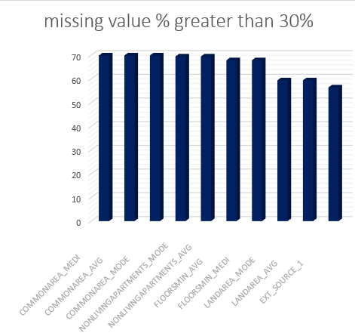
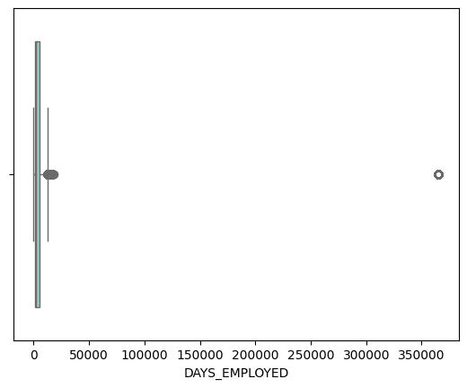
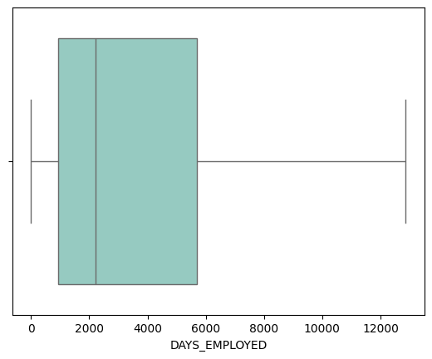
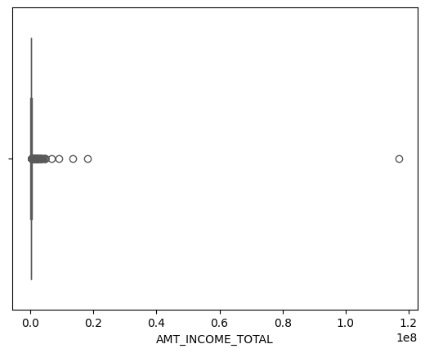
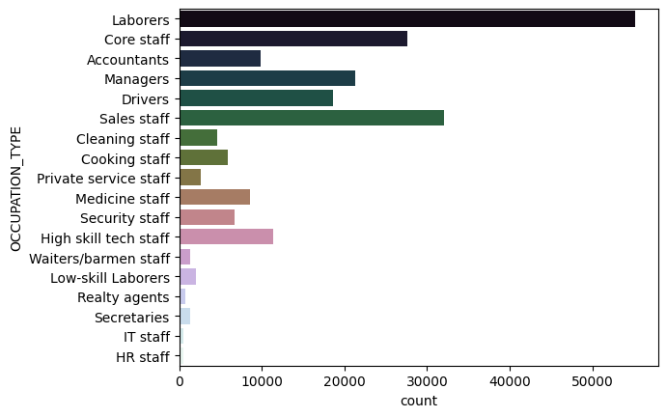
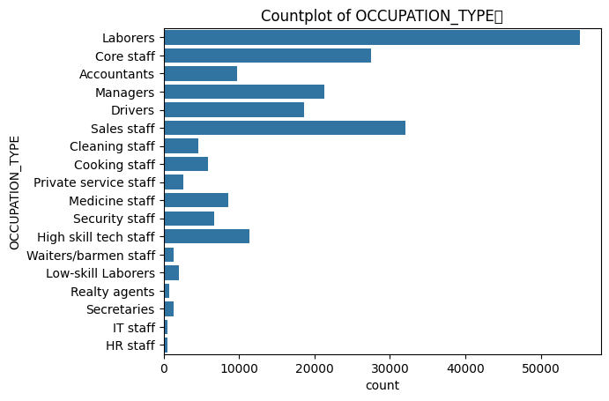
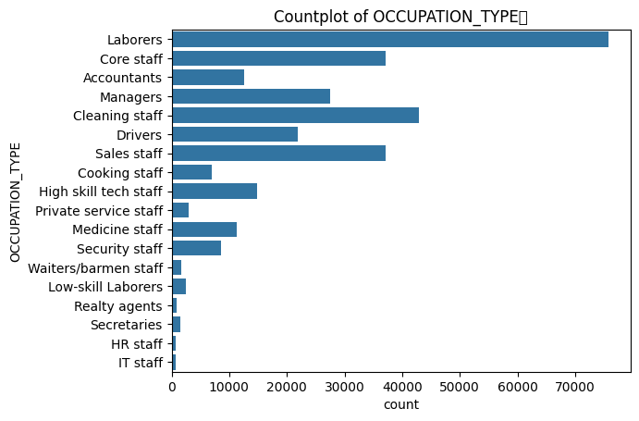
DATA PREPROCESSING
HANDLING NULL VALUES
2. OWN_CAR_AGE
RELATIONSHIP BETWEEN "FLAG_OWN_CAR" and "OWN_CAR_AGE"
There were 5 missing values for customers who owned car
Logically collected related columns
FLAG_OWN_CAR
OWN_CAR_AGE
CODE_GENDER
DAYS_BIRTH
DAYS_EMPLOYED
OCCUPATION_TYPE
CNT_FAM_MEMBERS
Predicted these 5 columns using regression imputation
1. OCCUPATION_TYPE
AMT_INCOME_TOTAL 0.000000
OCCUPATION_TYPE 31.345545
ORGANIZATION_TYPE 0.000000
NAME_INCOME_TYPE 0.000000
NAME_EDUCATION_TYPE 0.000000
DAYS_EMPLOYED 0.000000
AMT_REQ_CREDIT_BUREAU
DATA IS MISSING COMPLETELY AT RANDOM
Multiple Imputation by Chained Equations (MICE): Pros: Captures relationships between variables, provides multiple imputations for uncertainty estimation. Cons: Computationally intensive
"AMT_REQ_CREDIT_BUREAU_HOUR" ,"AMT_REQ_CREDIT_BUREAU_DAY", "AMT_REQ_CREDIT_BUREAU_WEEK", "AMT_REQ_CREDIT_BUREAU_MON", "AMT_REQ_CREDIT_BUREAU_QRT", "AMT_REQ_CREDIT_BUREAU_YEAR"
50 columns had more than 30% or more missing values
Base Model removed columns with null value % more than 35 %
Imputed these values with mean mode median
Final model- went with some unorthodox methods as well as standard methods
Filling missing values with random forest classifier

Slide 9
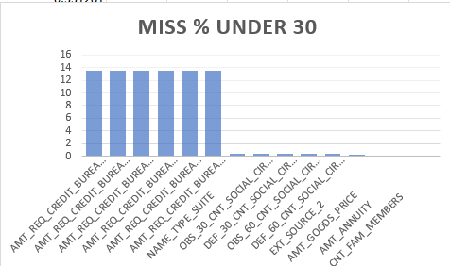
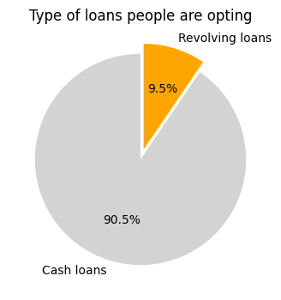
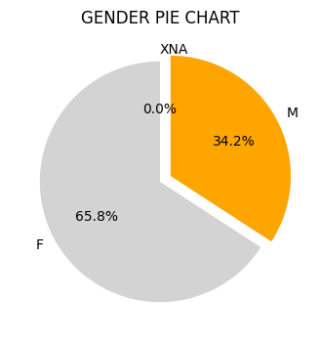
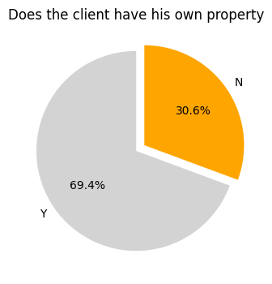
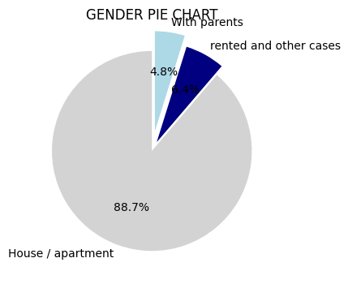
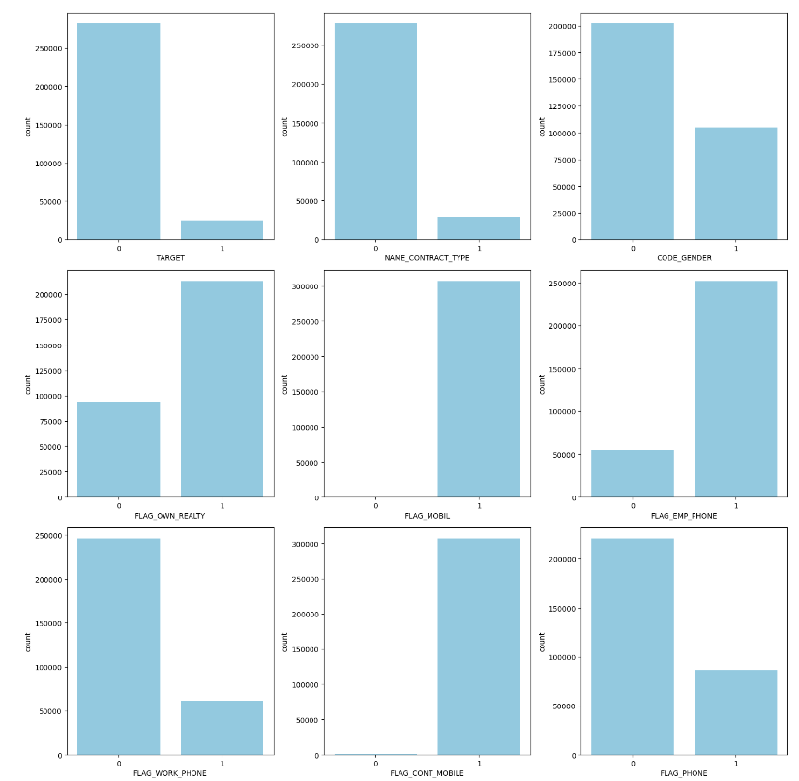
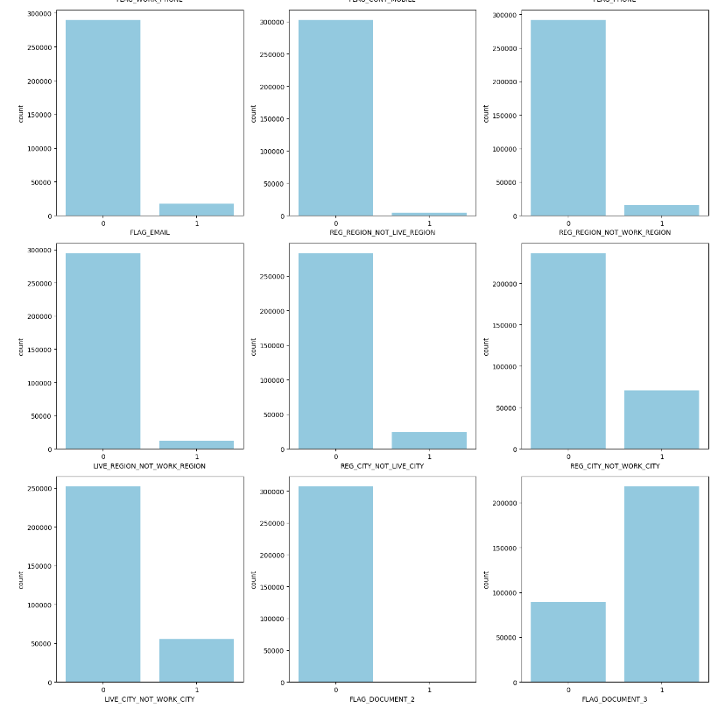
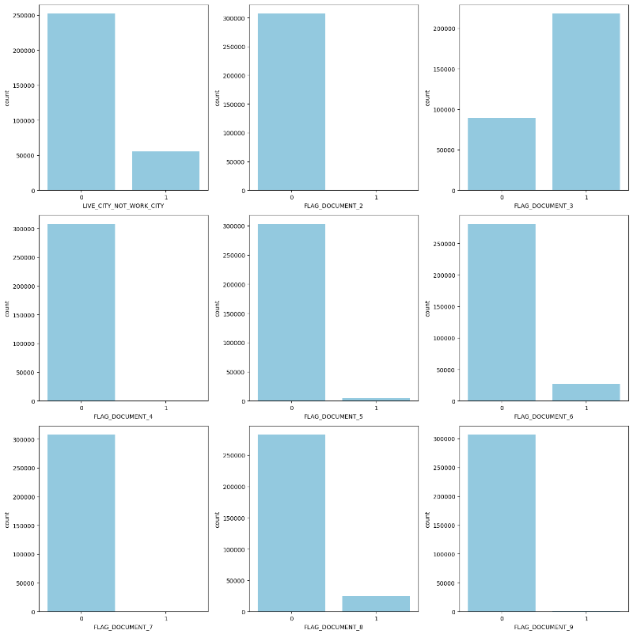
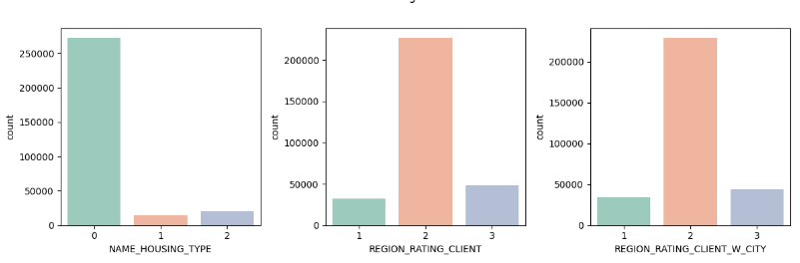
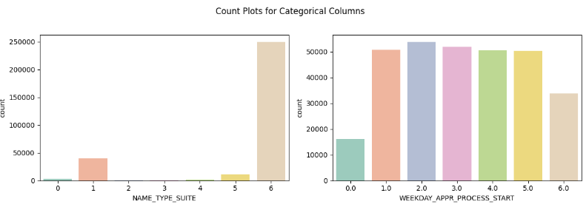
HANDLING OUTLIERS
NAME_TYPE_SUITE
NAME_TYPE_SUITE","CNT_FAM_MEMBERS","CNT_CHILDREN", "NAME_FAMILY_STATUS", "AMT_INCOME_TOTAL", "NAME_EDUCATION_TYPE", "DAYS_EMPLOYED", "DAYS_BIRTH", "OCCUPATION_TYPE", "ORGANIZATION_TYPE“
Decision tree imputation
VALUES LESS THAN 15%
Columns with missing values less than 10%:
'AMT_ANNUITY’
'AMT_GOODS_PRICE’
'CNT_FAM_MEMBERS’
DROPPED "FLAG_MOBIL“ since all the values were 1
COLUMNS related to house were having very high null values
"FLAG_OWN_REALTY" checks whether Does the client has a property or not
"NAME_HOUSING_TYPE": What is the housing situation of the client (renting, living with parents, ...)
Conclusions
Surprisingly people who are having the required conditions have missing info regarding the houses
This may be because these info might not be required when apply for different types of loans
Such a kind of information are available in case of people who are applying for housing loans
Here I am dropping these columns
binary columns which were having individual values only were dropped
More than 3 which was showing irregular shapes were clubbed together
All the categorical columns were then encoded

Slide 10
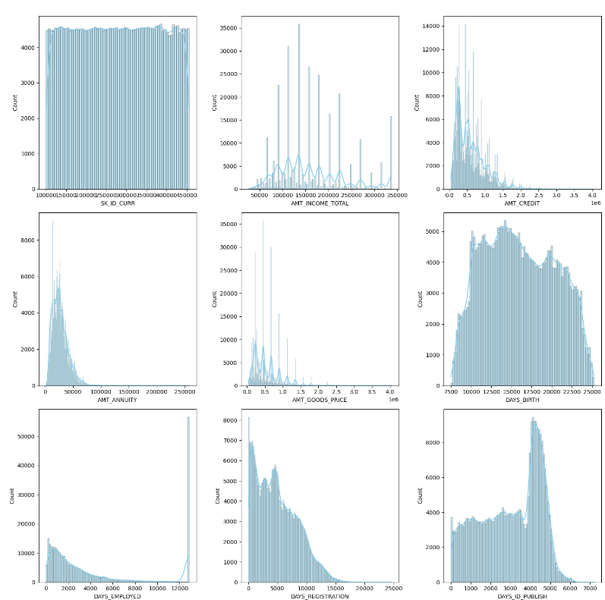
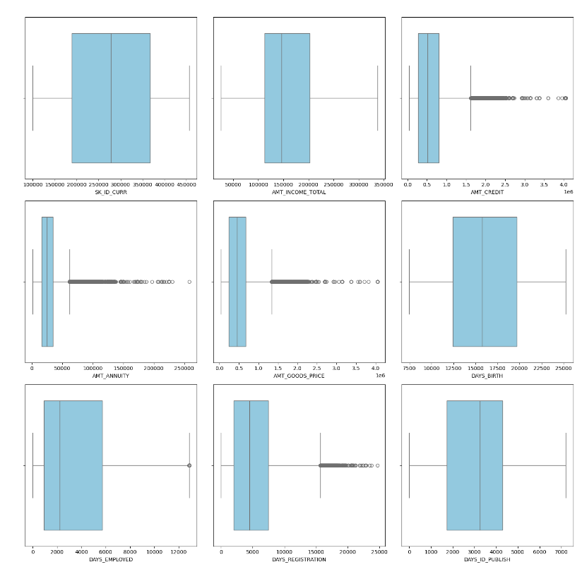
HANDLING OUTLIERS
1. Numerical Input, Numerical Output
This is a regression predictive modeling problem with numerical input variables.
The most common techniques are to use a correlation coefficient, such as Pearson’s for a linear correlation, or rank-based methods for a nonlinear correlation.
• Pearson’s correlation coefficient (linear).
• Spearman’s rank coefficient (nonlinear)
2. Numerical Input, Categorical Output
This is a classification predictive modeling problem with numerical input variables. This might be the most common example of a classification problem. Again, the most common techniques are correlation based, although in this case, they must take the categorical target into account.
• ANOVA correlation coefficient (linear).
• Kendall’s rank coefficient (nonlinear).
3. Categorical Input, Numerical Output
This is a regression predictive modeling problem with categorical input variables. This is a strange example of a regression problem (e.g. you would not encounter it often). Nevertheless, you can use the same “Numerical Input, Categorical Output” methods (described above), but in reverse.
4. Categorical Input, Categorical Output
This is a classification predictive modeling problem with categorical input variables. The most common correlation measure for categorical data is the chi-squared test. You can also use mutual information (information gain) from the field of information theory.
Chi-Squared test (contingency tables).
Mutual Information.
In fact, mutual information is a powerful method that may prove useful for both categorical and numerical data, e.g. it is agnostic to the data types.

Slide 11
HANDLING OVERSAMPLING
MODEL BUILDING
Target class imbalance occurs when the number of instances in different classes varies significantly in a dataset.
Imbalanced classes can lead to biased model performance.
Addressing class imbalance is crucial for accurate and fair machine learning models
METHOD | ADVANTAGES
Random Oversampling (RandomOverSampler) | Advantages: Simple and easy to implement. Considerations: May lead to overfitting on the minority class if the oversampling is too aggressive.
SMOTE (Synthetic Minority Over-sampling Technique) | Advantages: Generates synthetic samples by interpolating between existing minority class instances. Considerations: May be sensitive to noisy data and may not perform well if the feature space is high-dimensional.
ADASYN (Adaptive Synthetic Sampling): | Advantages: Similar to SMOTE but adapts the sampling density according to the local distribution of the minority class. Considerations: Can be computationally more expensive than SMOTE.
BorderlineSMOTE: | Advantages: Focuses on borderline instances, which are samples that are close to the decision boundary. Considerations: May be less sensitive to noisy data than standard SMOTE.
SMOTE-ENN (SMOTE with Edited Nearest Neighbors): | Advantages: Combines SMOTE with the removal of noisy samples using ENN. Considerations: ENN may remove informative minority class samples.
MODEL | OUTLIERS | MULTICOLLINEARITY | CLASS IMBALANCE
Logistic regression | SENSITIVE | SENSITIVE | SENSITIVE
Naïve bayes | NOT VERY SENSITIVE | NOT SENSITIVE | MODERATE
Decision tree | NOT VERY SENSITIVE | NOT VERY SENSITIVE | SOMEWHAT SENSITIVE
Random forest | LESS SENSITIVE | LESS SENSITIVE | NOT SENSITIVE
XgBOOST | MODERATELY SENSITIVE | LESS SENSITIVE | NOT SENSITIVE
AdaBOOST | SENSITIVE | LESS SENSITIVE | SENSITIVE
GradientBOOST | SENSITIVE | LESS SENSITIVE | SENSITIVE

Slide 12
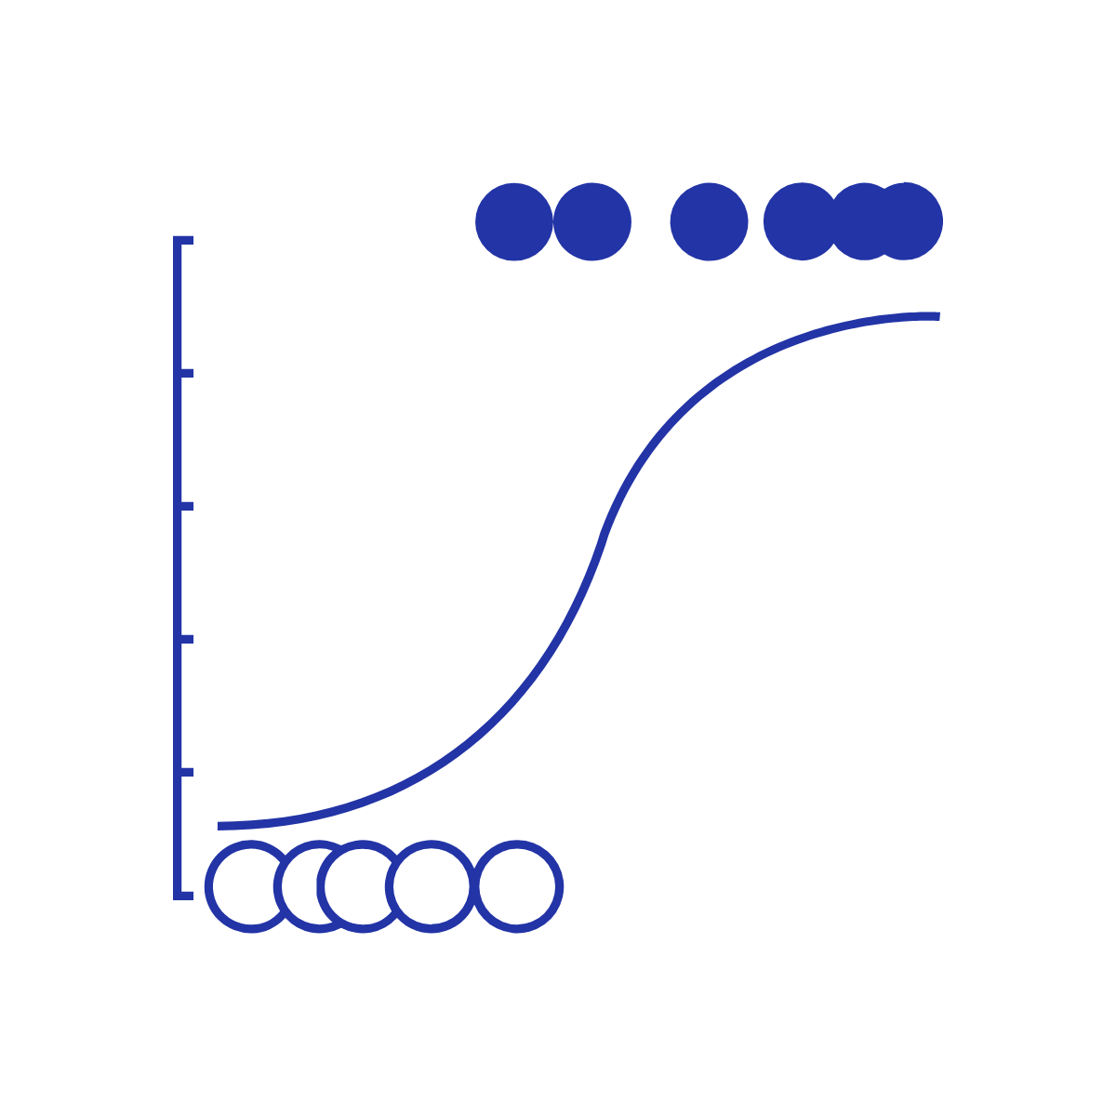
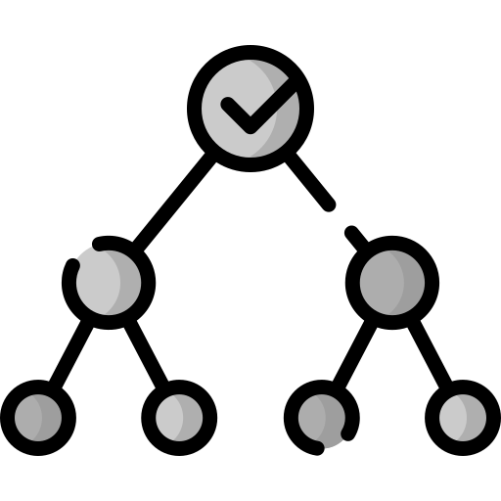
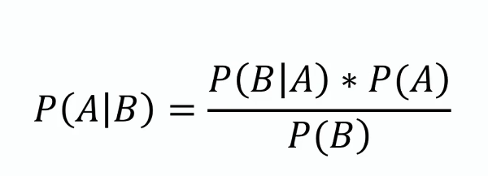
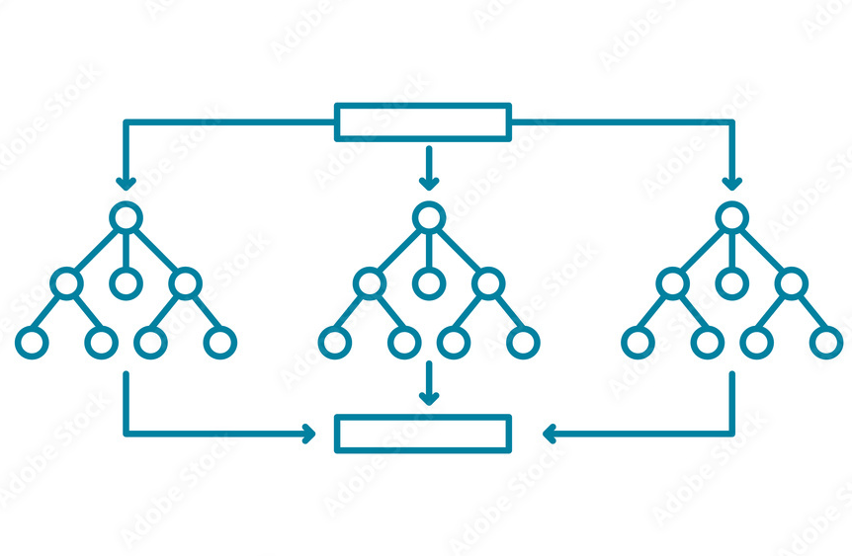

CLASSIFICATION MODELS ASSUMPTIONS
LOGISTIC REGRESSION
Linear relationship between features and log-odds of the response variable.
Absence of multicollinearity (high correlation between independent variables).
Observations are independent of each other.
No significant outliers in the data.
Dependent variable is binary or ordinal
DECISION TREE
Assumes data is axis-aligned (splits are made along the axes).
Non-parametric, so no specific distributional assumptions.
Can handle both numerical and categorical data.
NAIVE BAYES
Assumes independence between features given the class.
Assumes features follow a specified distribution (e.g., Gaussian for continuous features in Gaussian Naive Bayes).
RANDOM FOREST
Ensemble method that builds multiple decision trees.
Each tree is constructed independently, and their predictions are averaged.
Can handle missing values and maintain accuracy with imbalanced classes
ADAGBOOST
Ensemble method that combines multiple weak learners.
Each weak learner is assigned a weight based on its performance.
Assumes that weak learners perform better than random chance.
XGBOOST
Ensemble method based on boosting.
Uses a gradient boosting framework.
Regularization terms are applied to control overfitting
GRADIENT BOOST
Ensemble method that builds trees sequentially.
Minimizes a loss function through gradient descent.
Can be sensitive to outliers and noise.

Slide 13
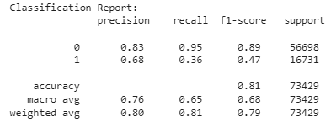
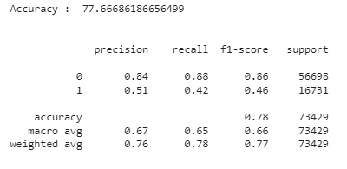
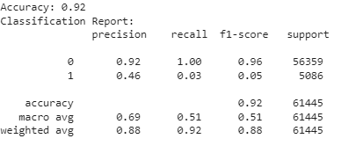
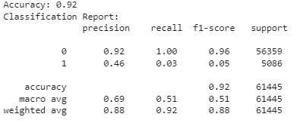
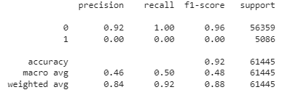
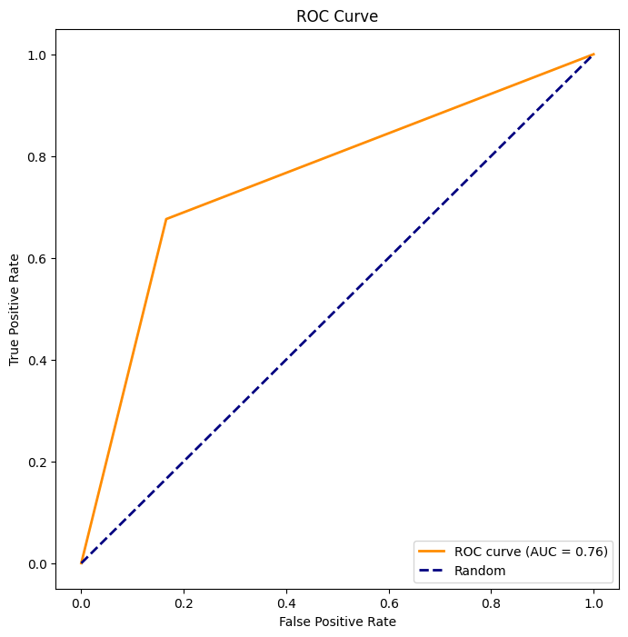
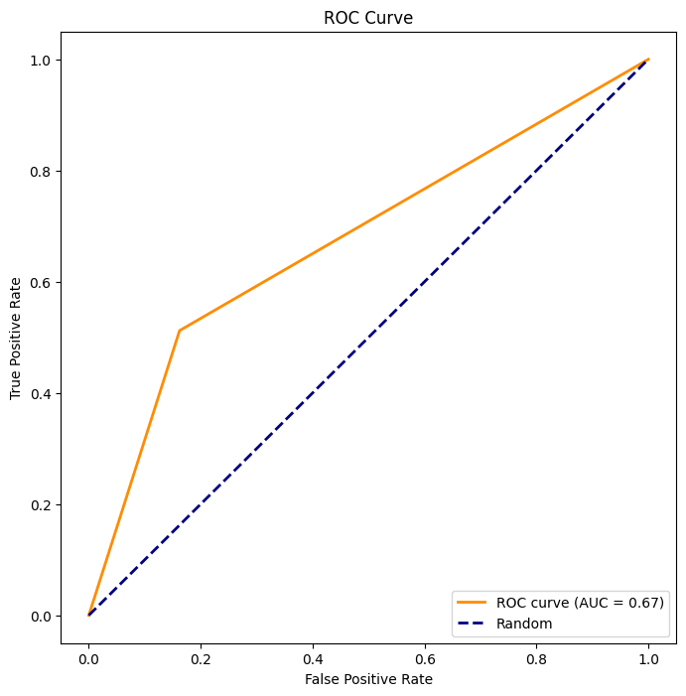
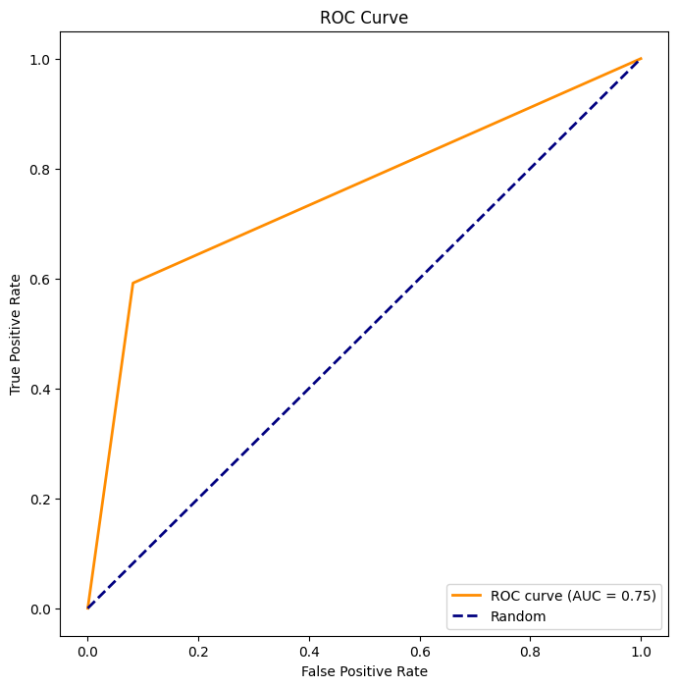
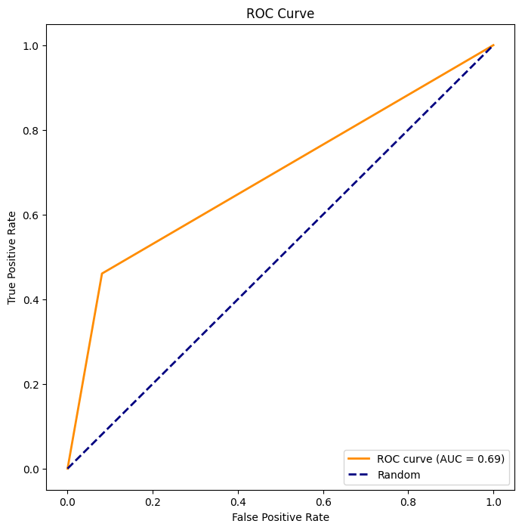
PERFORMANCE EVALUATION BASE MODEL
LOGISTIC REGRESSION
ADA BOOST
XG BOOST
DECISION TREE
GRADIENT BOOST

Slide 14
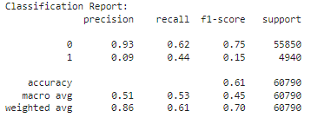
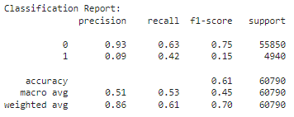
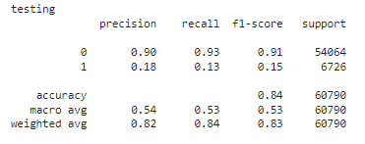
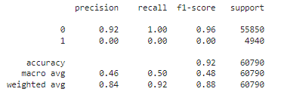
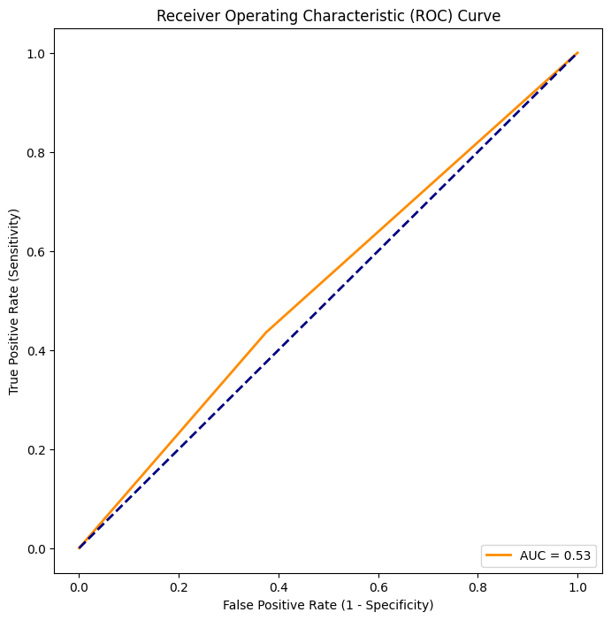
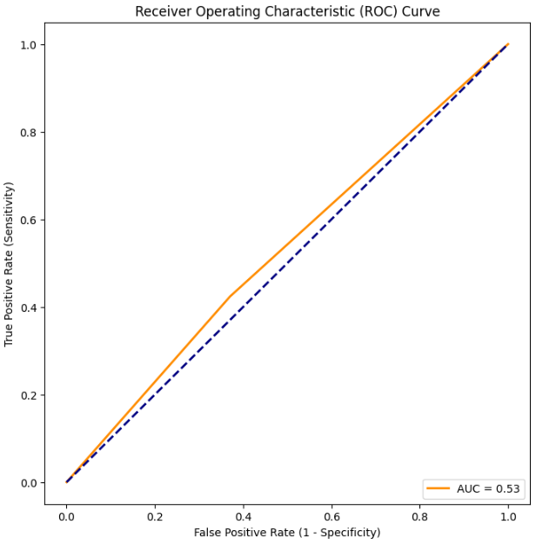


PERFORMANCE EVALUATION BASE MODEL
PERFORMANCE EVALUATION MODEL - 2
LOGISTIC REGRESSION
LOGISTIC REGRESSION WITH WEIGHTS
DECISION TREE
NAIVE BAYES

Slide 15




PERFORMANCE EVALUATION BASE MODEL
RANDOM FOREST
ADA BOOST
XG BOOST
GRADIENT BOOST

Slide 16










PERFORMANCE EVALUATION BASE MODEL
PERFORMANCE EVALUATION FINAL MODEL
DECISION TREE
RANDOM FOREST
ADA BOOST
GRADIENT BOOST
XG BOOST
0.80
0.84
0.79
0.84
0.85

Slide 17





CONCLUSION
FUTURE WORK: A LIVE APPLICATION
Our Creditworthiness Evaluation project employed a diverse set of classification models, including Logistic Regression, Decision Tree, Naive Bayes, SVM, Random Forest, XGBoost, AdaBoost, and Gradient Boost.
1. Model Diversity and Robustness:
The use of multiple classification models allowed for a comprehensive understanding of credit risk assessment, capturing diverse decision-making approaches.
2.Performance Variation:
Models exhibited varying performance metrics, highlighting the importance of selecting the right algorithm for the specific characteristics of the dataset. Random Forest and XGBoost, for instance, demonstrated high accuracy and robustness.
3. Interpretability vs. Complexity Trade-off:
Decision Tree and Naive Bayes offered interpretability, aiding in understanding feature importance. However, more complex models like XGBoost and Random Forest, while achieving high accuracy, presented challenges in interpretability.
4. Ensemble Methods' Strength:
Ensemble methods, such as Random Forest, XGBoost, AdaBoost, and Gradient Boost, showcased superior performance by combining multiple weak learners. They proved effective in handling complex relationships within the data.
Regularly retraining the model with updated data and continuously improving its accuracy and fairness are critical for maintaining its effectiveness in dynamic financial landscapes.
Ongoing validation against new and diverse datasets is crucial to ensure its robustness in real-world scenarios.
Model
validation
Monitoring and Continuous Imp
Develop UI
UI DevelopmentClear and interpretable information presentation contributes to user confidence and understanding.
Compliance and Explainability
External Data
Incorporating real-time and additional external data sources, such as economic indicators and market trends, can enhance the model's predictive capabilities. Regular updates to these external inputs ensure the model adapts to changing economic conditions.
Implementing mechanisms for transparency and interpretability is essential for building trust among users and regulatory authorities.

